Slide 1
Itq end-course project
EITAN BEN ARI

Slide 2
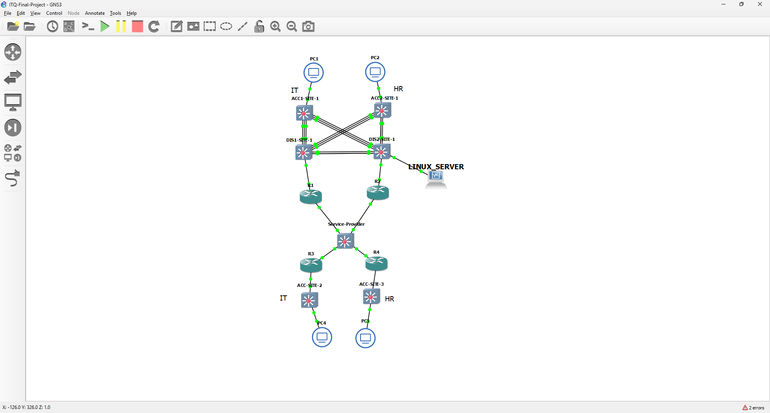
TOPOLOGY VIEW
Press the pdf icon for Ip address scheme

Slide 3
Layer 2 Security Enhancements
I created a native VLAN to streamline the management of untagged traffic and improve network efficiency. For the IT department, I established a dedicated VLAN to ensure that their resources are organized and secure, allowing for improved performance and enhanced security measures. Similarly, I created a separate VLAN for the HR department, providing them with a distinct space that facilitates better access control and security for sensitive information.
Additionally, I configured a dedicated VLAN for unused and powered-off ports in any site, to ensure that if an intruder tries to activate them, they will not be able to penetrate the network. These configurations enhance overall network security by segmenting traffic, reducing the risk of unauthorized access, and ensuring that each department can operate efficiently within its designated space.
Of course, each of these VLANs is assigned a unique VLAN ID per site to enhance security and minimize the risk of cross-site vulnerabilities.
ARP Inspection was implemented to prevent ARP spoofing attacks, ensuring that only valid ARP traffic is processed. By validating ARP requests and responses, it enhances network security and maintains the integrity of device communications.
Note: At the end of each explanation in the presentation, you will find the corresponding configuration details, including the specific commands used

Slide 4
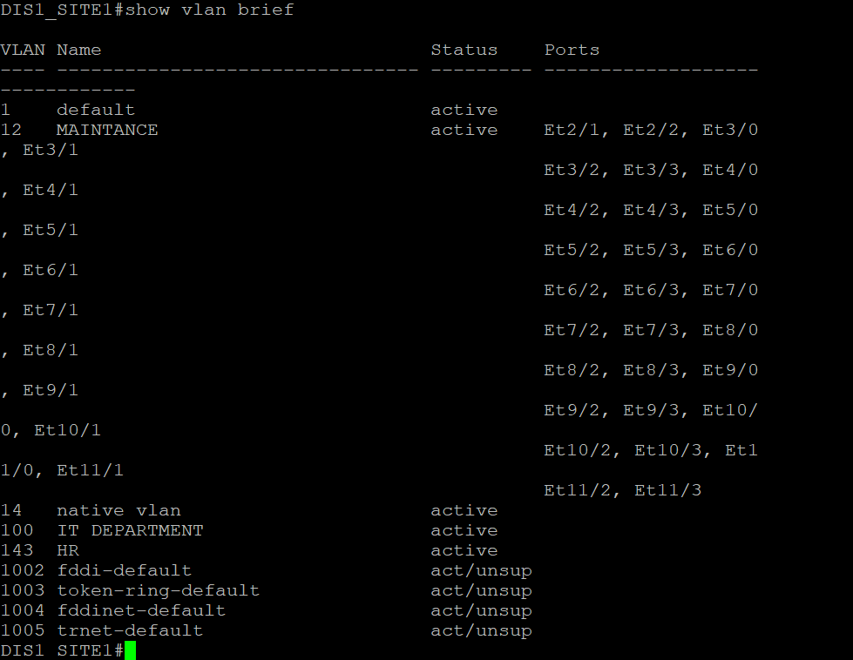
In this configuration example from Site 1, four VLANs have been implemented:
VLAN for Powered-Off Ports: This VLAN is designated for unused ports, ensuring that they do not inadvertently connect to the network.
Native VLAN: VLAN 12 is set as the native VLAN, facilitating the management of untagged traffic.
VLAN for IT: VLAN 100 is specifically created for the IT department, ensuring organized and secure access to network resources.
VLAN for HR: VLAN 143 is dedicated to the HR department, providing a secure environment for handling sensitive information.
Note: At this site, both IT and HR personnel are active, resulting in two broadcast domains for both departments.

Slide 5
port channel- implemented Port Channel LACP (Link Aggregation Control Protocol) between the distribution and access switches, as well as among the distribution switches themselves, to enhance network resilience and bandwidth. By aggregating multiple physical links into a single logical connection, LACP provides redundancy; if one link fails, traffic is seamlessly redirected through the remaining links. This configuration not only improves overall throughput but also enhances security by minimizing the risk of network disruptions. Additionally, LACP helps balance the load across the aggregated links, optimizing performance while maintaining a secure and efficient Layer 2 environment.
Port security -Port Security helps protect against MAC flooding, unauthorized access, and MAC spoofing by limiting network access to authorized devices only. This strengthens network security and prevents attackers from overwhelming or impersonating devices on end-user ports.
I configured Port Security with the default max count of 1, restrict violation mode, and used the mac address sticky feature. Using the mac-address sticky feature allows the switch to automatically learn and lock each device’s MAC address to its specific port(saves it to RAM, in order to save it non temporarily you need to use ‘WR’ or ‘copy running-config startup-config’ providing seamless management. The restrict mode blocks unauthorized devices ate users. This setup enhances control and stability across end-user connections, making the network more secure against potential attacks.
Note: At the end of each explanation in the presentation, you will find the corresponding configuration details, including the specific commands used

Slide 6
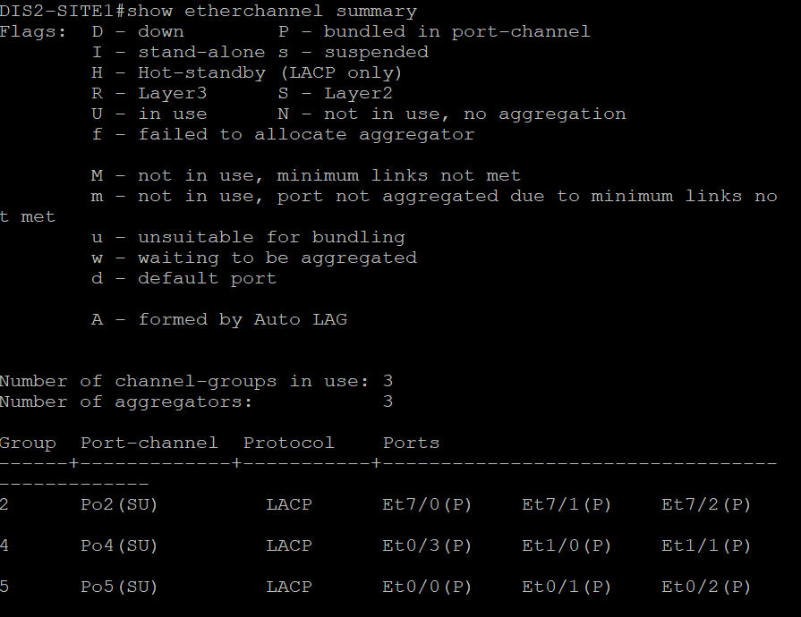
In this example from another distribution switch at Site 1, there are three Port Channel bundles configured, each comprising three links. All links are marked with "P" (Protocol), indicating they are active and managed by a link aggregation protocol, such as LACP or PAGP. This configuration enhances bandwidth and provides redundancy, ensuring that traffic can be balanced across the active links. In the output of the show EtherChannel summary command, the "U" (Up) status indicates that the links are operational and forwarding traffic, while the "P" signifies that they are part of a protocol-based EtherChannel.

Slide 7
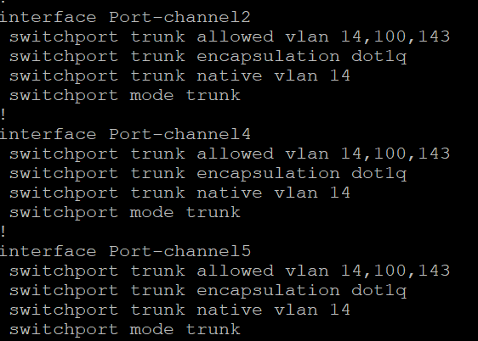
***a Port Channel interface is configured like any other physical interface after the command channel-group [group id] mode [mode].
[group id]: This specifies the Port Channel group number assigned to the interface. You cannot assign two bundles with identical group IDs, as this will overwrite the existing bundle.
[mode]: This defines the mode of operation for the EtherChannel, such as on, active (for LACP), passive (for LACP), desirable, or auto (for PAGP).

Slide 8
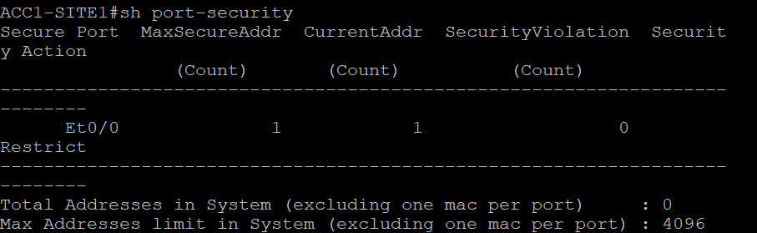
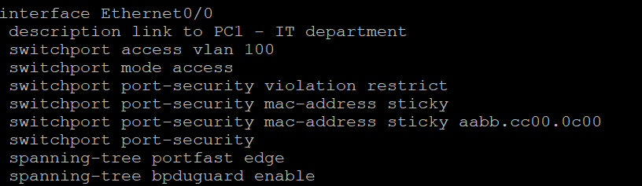
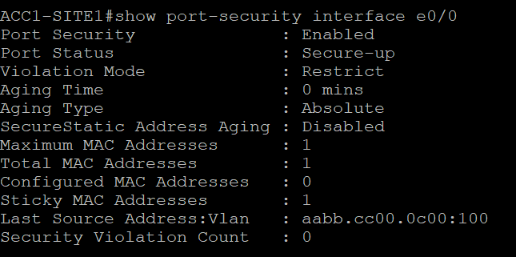
- an example from an access switch in site 1 , where Port Security is enabled on interface e0/0 with violation restrict. The maximum number of MAC addresses is set to the default value of 1, and this is currently the count of MAC addresses learned on this interface.
sticky MAC addressing is enabled, and it has successfully captured the MAC address of the connected device. This feature enhances security by automatically associating the device's MAC address with the corresponding port, ensuring that only authorized devices can access the network.
The last MAC address is aabb.cc00.0c00 from VLAN 100. Address aging is disabled, which means that the learned MAC address will not be removed from the MAC address table after a period of inactivity. the status of the port is secured, indicating that Port Security is actively protecting the port.

Slide 9
Vlan pruning - VLAN Pruning is a technique used in switched networks to optimize performance by limiting the VLANs that can pass through trunk links. It restricts the VLANs allowed on trunk links, reducing unnecessary broadcast traffic. The benefits include reduced broadcast traffic leading to improved network performance, enhanced security by limiting VLAN access, and simplified network management by minimizing the number of VLANs on trunk links. Overall, VLAN pruning helps ensure that network resources are used effectively and efficiently.
IP DHCP snooping - IP DHCP Snooping is a network security feature that allows network administrators to control which devices can respond to DHCP requests, enhancing security within the network. The primary purpose is to create a binding table that associates IP addresses with MAC addresses, ensuring that only trusted DHCP servers can assign IP addresses to clients.
Administrators configure switches to define trusted and untrusted ports, typically marking ports connected to legitimate DHCP servers as trusted. The benefits include preventing DHCP spoofing attacks, maintaining a secure network environment, and ensuring that clients receive valid IP configurations from authorized servers. Overall, IP DHCP Snooping helps safeguard network integrity and improve management of IP address assignments.
Note: At the end of each explanation in the presentation, you will find the corresponding configuration details, including the specific commands used

Slide 10
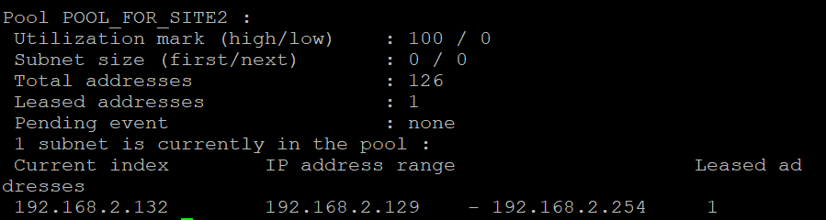
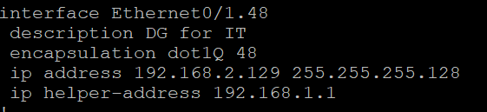

Show ip dhcp pool output -ROUTER1_SITE1
In this example, I will securely obtain IP addresses for the SITE 2’s LAN
from ROUTER 1.
In Router 1, there is a pool configured for the LAN of Site 2 in order to successfully assign IP addresses to devices in that site, I configured the IP helper address on e/1.48 interface of the site 2 router to deliver DHCP requests to 192.168.1.1(R1s interface)
IP Helper Overview
IP helper is a router feature that forwards DHCP requests from clients in one subnet to a DHCP server in another subnet. Since broadcast messages don't cross router boundaries, the IP helper address intercepts these requests and sends them as unicast messages
Show run output –ROUTER_SITE2

Slide 11

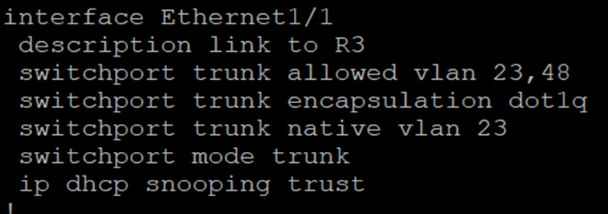
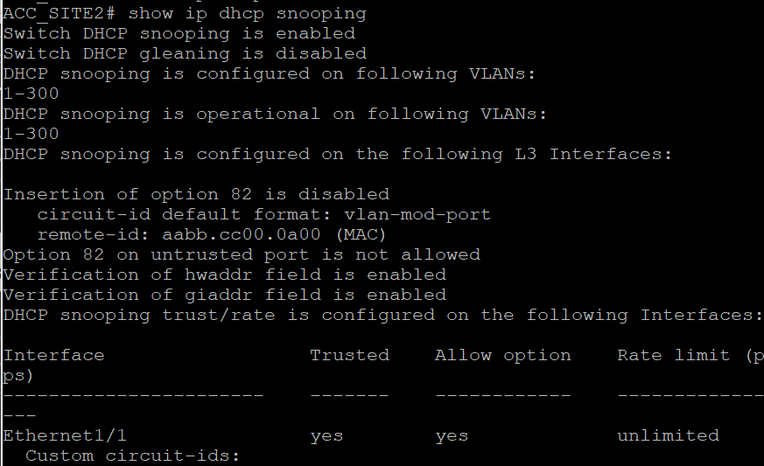
Show run – access switch site 2
The ip dhcp snooping command enables DHCP snooping on a switch to protect against rogue DHCP servers. By default, all ports are untrusted, meaning they cannot send DHCP responses. DHCP snooping monitors DHCP messages, creates a binding table of IP-to-MAC address mappings, and allows only trusted ports to assign IP addresses, securing the DHCP process in the network.
For successfully transmitting DHCP offers and acknowledgments, I manually set port E1/1 to trusted.
Show ip dhcp snooping – access sw site 2
i applied no ip dhcp snooping info option on the switch to prevent it from inserting DHCP Option 82 data, ensuring only the router handles this function as a DHCP relay agent

Slide 12
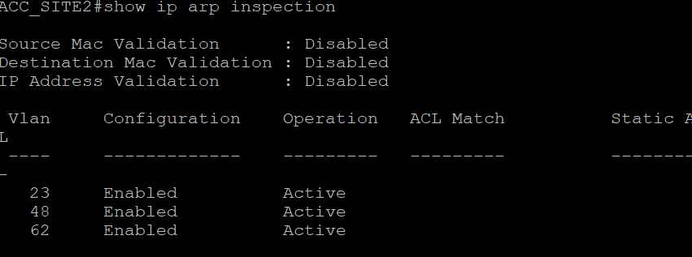
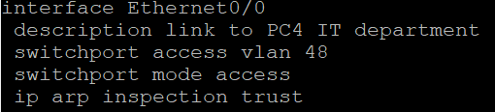
I enabled ip arp inspection to protect against ARP spoofing by verifying ARP messages. Then, by applying ip arp inspection trust, you marked the router's port as trusted, allowing ARP messages from that port to bypass the inspection, while other ports are still checked.

Slide 13
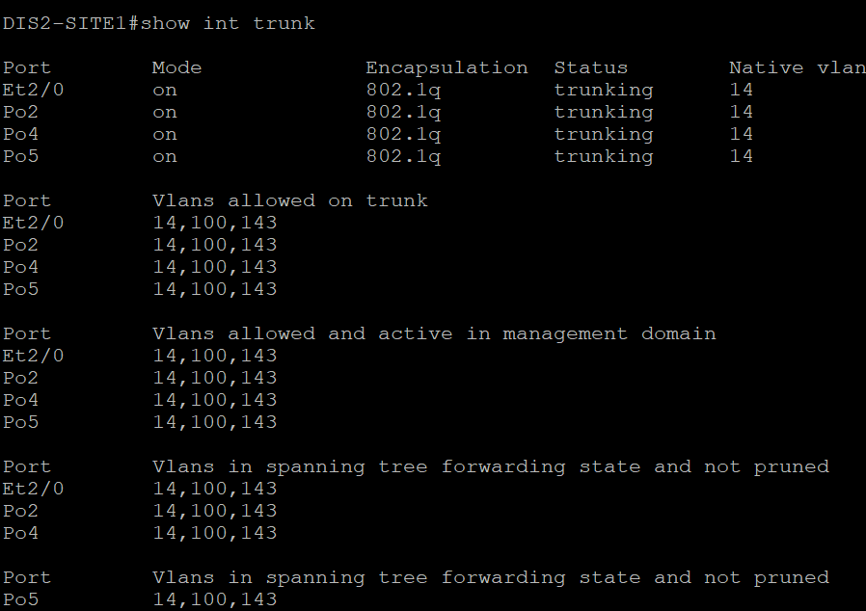
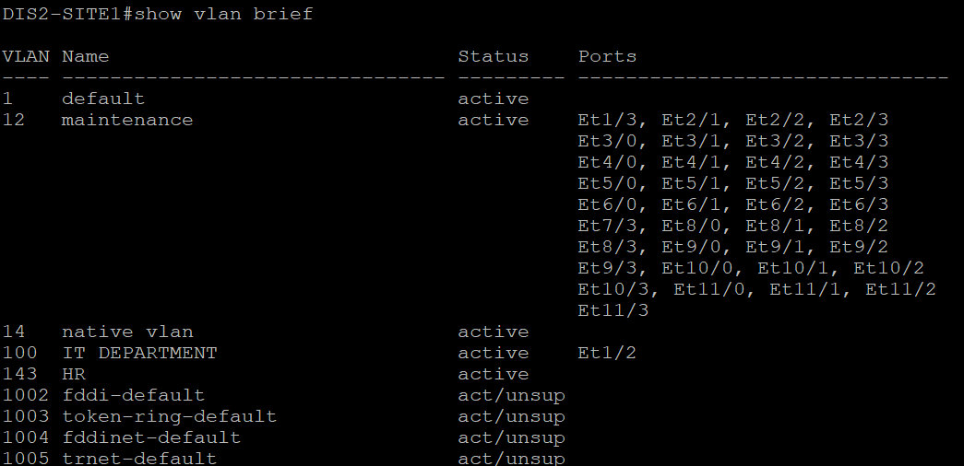
On the DIS2 switch at Site 1, only specific VLANs are permitted on all trunk links: VLAN 14 (Native), VLAN 100 (IT), and VLAN 143 (HR). The “Black Hole VLAN” ,vlan 12(“named maintenance”) has been removed from the trunk to enhance security, ensuring that only essential traffic is allowed across inter-switch connections.
Assigning disabled interfaces to a dedicated maintenance VLAN (such as VLAN 12) and excluding this VLAN from the allowed VLANs on trunk links helps visually and functionally separate inactive ports from the active network. This setup ensures that, even if a disabled port is accidentally activated, it won’t be able to transmit traffic across the network, maintaining better organization and security.

Slide 14
Rapid Spanning tree(802.1w) - I have configured Rapid Spanning Tree Protocol (RSTP) across all switches in the network to ensure fast convergence and efficient path management. Additionally, I implemented different root bridges per VLAN at one site for load balancing purposes by adjusting the bridge priority values on the switches. This allows for the distribution of forwarding responsibilities among various switches, minimizing the risk of network congestion and improving overall performance. With RSTP, the network remains resilient and responsive to topology changes, ensuring high availability and reliability in a dynamic environment.
In addition, I configured PortFast and BPDU Guard on the ports designated for end-user devices. This setup ensures that these ports transition to the forwarding state immediately upon device connection, minimizing connection delays. By enabling BPDU Guard, any received Bridge Protocol Data Units (BPDUs) on these ports will cause the port to be shut down, preventing potential topology changes and ensuring network stability. This combination further enhances the security and performance of the network for end-user connections.
Note: At the end of each explanation in the presentation, you will find the corresponding configuration details, including the specific commands used

Slide 15
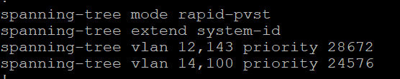
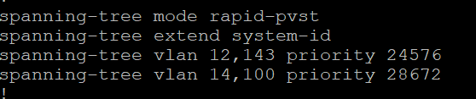
DIS1 SWITCH
The configuration on both distribution switches of Site 1 shows that the spanning-tree mode rapid-pvst command is applied to enable Rapid PVST. DIS 1 is configured as the ROOT BRIDGE for VLAN 100 (IT) and VLAN 14 (native), and serves as the SECONDARY ROOT for VLAN 12 (Black Hole) and VLAN 143 (HR VLAN).
In contrast, DIS2 acts as the ROOT BRIDGE for VLAN 12 (Black Hole vlan ) and VLAN 143 (HR VLAN) while serving as the SECONDARY ROOT for VLAN 14 (native) and VLAN 100 (IT). This setup enhances load balancing and redundancy within the network.
DIS2 SWITCH
***Configuring the same root bridge for all VLANs can waste bandwidth, as it forces all traffic to converge through a single point. This setup can create bottlenecks under heavy loads, degrading performance since all VLAN traffic must pass through the designated root bridge. By distributing root bridges across different VLANs, bandwidth usage is optimized, enabling more efficient traffic handling and reducing the risk of congestion.

Slide 16
VRRP for Default Gateway Redundancy in Site 1
Virtual Router Redundancy Protocol (VRRP) is a network protocol designed to enhance the availability and reliability of IP routing. It enables multiple routers to collaborate within a single group, designating one router as the master and others as backups. Should the master router fail, a backup router can seamlessly assume its role, ensuring uninterrupted connectivity for devices within the network.
In my configuration, I used VRRP to provide redundancy and load balancing for two departments that need reliable external communication. Router 1 is the master for the IT VLAN, while Router 2 is the master for the HR VLAN. This setup ensures that both departments have a reliable default gateway and helps balance traffic between the two routers. By distributing routing tasks, I enhance network resilience, ensuring continuous connectivity even if one router fails, thus improving performance and reliability for both the IT and HR departments.
Note: At the end of each explanation in the presentation, you will find the corresponding configuration details, including the specific commands used

Slide 17
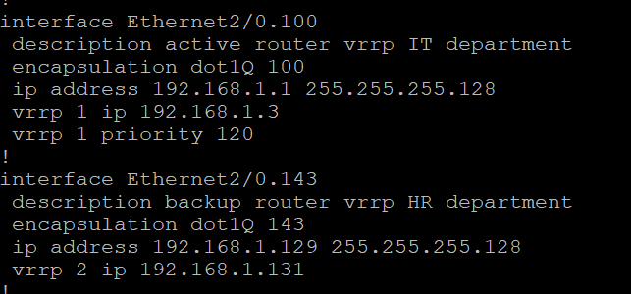
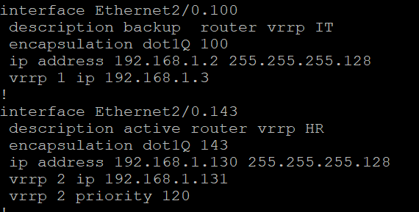
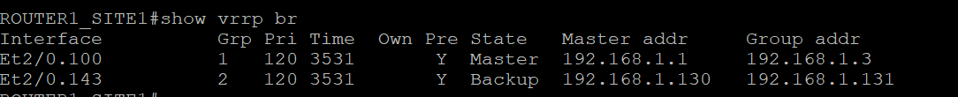
Router 1
Router 2
***Preemption operates automatically in VRRP, allowing a router with a higher priority to take control immediately when it becomes available.
According to the output of the show vrrp brief command on Router 1, and show run on both routers -the virtual IP address for VLAN 100 between the active and backup routers is 192.168.1.3, while for VLAN 143, it is 192.168.1.131.

Slide 18
GRE OVER IPSEC TUNNELS
GRE enables encapsulation of various types of traffic, such as multicast and non-IP protocols, creating flexible connectivity between remote networks but lacks encryption or security, leaving traffic exposed to threats
IPsec provides strong encryption and security for traffic, ensuring privacy, integrity, and authentication by protecting data in transit, but it is limited to IP traffic only and does not support other protocols like multicast, which reduces flexibility
The solution is to use GRE over IPsec, where GRE encapsulates various protocols, and IPsec secures the encapsulated traffic, creating a secure and flexible VPN connection between remote networks.
To ensure secure communication between the three sites, I implemented GRE over IPSec tunnels from any site to any site. First, I configured static routing at the underlay level to allow GRE packets to reach their destinations. This setup enables the transmission of encrypted GRE packets, ensuring secure and reliable communication across the network.
Afterward, I created the GRE tunnels and configured the IPSec stages, then advertised the tunnel interfaces and LAN interfaces in OSPF area 0.
***Advertising overlay and underlay networks within the same protocol can create routing conflicts and ambiguity, leading to inefficient path selection and potential loops. It's essential to maintain separation to ensure optimal routing decisions and network stability.

Slide 19
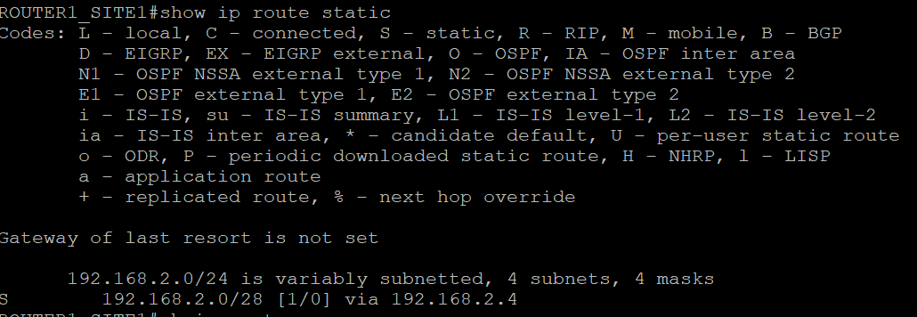
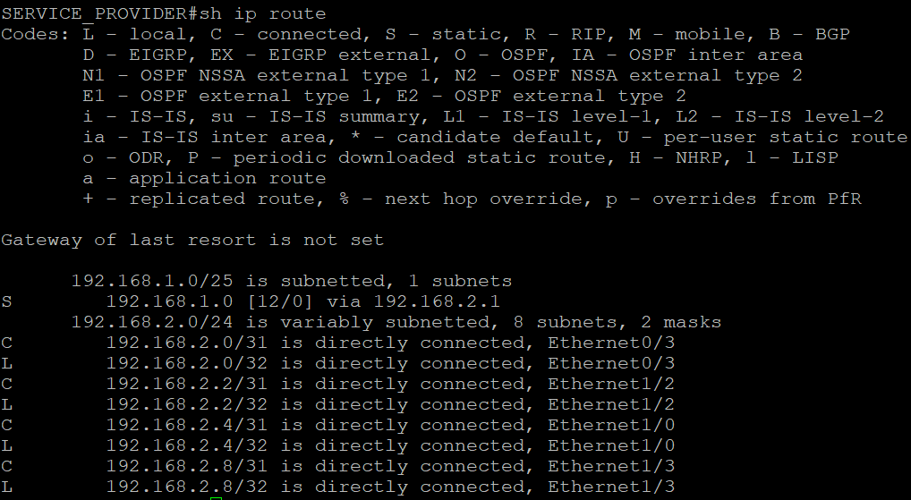
The subnet 192.168.2.0/28 encompasses all point-to-point networks between the routers and the service provider, specifically between Router 1 and the Service Provider, Router 2 and the Service Provider, Router 3 and the Service Provider, and Router 4 and the Service Provider.
detailed overview of the p2p networks from the show ip route output of the Service Provider router . It is crucial that each site has an available route to the other sites at the underlay level; without this, OSPF adjacency cannot be established through the GRE over IPsec tunnel.

Slide 20
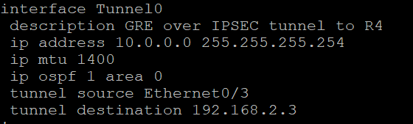
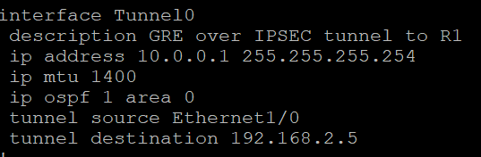
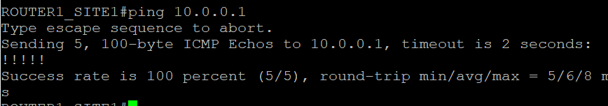
Example for configuring a GRE tunnel
Tunnel interface tunnel0: router 1
Setting the IP MTU(size of the packet) to 1400 on a tunnel interface prevents packet fragmentation by ensuring that the total frame size, including GRE and IPsec overhead, remains under the Ethernet limit of 1500 bytes.
Advertising the tunnel in OSPF(or other internal routing protocol such as eigrp ) is essential for exchanging routing information, ensuring connectivity between remote sites, and maintaining an updated routing table for efficient traffic flow.
Tunnel interface tunnel0: router 4
The tunnel source defines the originating interface or IP address of the tunnel, while the tunnel destination specifies the remote endpoint. This configuration is essential for establishing a GRE tunnel, ensuring reliable communication between routers.
The ICMP echo request to R4 through the tunnel was successful.

Slide 21
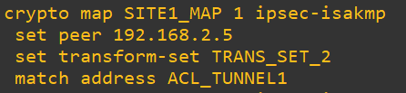
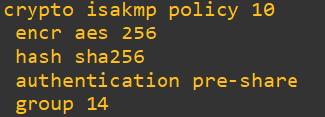
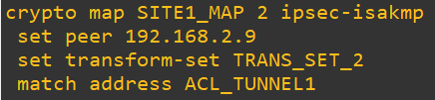
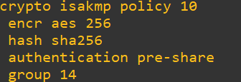

ROUTER3_SITE2
On one side of the GRE over IPsec tunnel on Router 3, I focused on the IPsec configuration. I created a transform set that specifies the encryption and hashing methods, such as AES for encryption and SHA for integrity. I then linked this transform set to a crypto map that identifies the remote peer. Additionally, I configured an ACL to define the interesting traffic that should be encrypted through the tunnel. Finally, I applied the crypto map to the external interface of Router 3. It’s important that the settings on the other side match this configuration to ensure proper tunnel operation.
ROUTER1_SITE1
On the other side of the GRE over IPsec tunnel, I configured Router 1 with mirrored settings, including the same transform set and a crypto map pointing to Router 3, while the ACL reflects the different source and destination addresses for the interesting traffic.

Slide 22
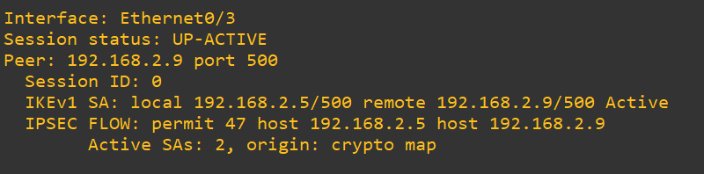
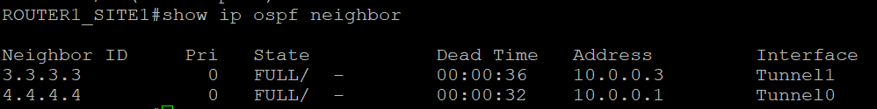
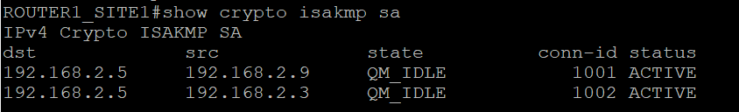
ROUTER 1 CLI OUTPUT
in R1 “show crypto session” command output we see that The tunnel is working because the session status is UP-ACTIVE, indicating activity. The peer connection confirms communication, and the active IKEv1 SA shows a valid security association. The IPsec flow permits GRE traffic, and there are 2 active SAs confirming encryption.
After completing the IPsec configuration, observing that R1 has maintained its OSPF adjacency with R3 indicates that the tunnel is established and operating as expected. This successful OSPF neighbor relationship confirms that encrypted traffic is passing through the tunnel correctly, ensuring secure and stable connectivity between R1 and R3.
The output shows the IKE SA state as QM_IDLE and status as ACTIVE, indicating the IPsec tunnel is successfully established, encryption is active, and both sides are ready to securely transfer data.

Slide 23
Automation tool - ansible
Using Ansible for network automation provides numerous advantages. Its simple YAML syntax makes it accessible for users with varying technical expertise. Ansible allows for centralized management of the network, streamlining configuration tasks and reducing device-switching.
I used Ansible to create access control lists (ACLs) and apply them to the VTY lines. Additionally, I configured login and exec banners, set up tunnel interfaces, and enabled secrets on all devices for enhanced security. This streamlined the process and ensured consistency across my network devices.
Using Ansible also accelerated the process by eliminating the need to configure each device manually, allowing for quicker and more efficient deployment of settings across the network.

Slide 24

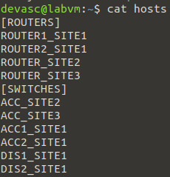
In the ansible.cfg file I created in my home directory , I configured the default settings for Ansible. I specified the inventory file to be ./hosts, which tells Ansible to use this file to find the list of devices. I also disabled host key checking by setting host_key_checking to false, which prevents Ansible from prompting for verification of the SSH host keys. Lastly, I set a timeout of 5 seconds, which defines the maximum time Ansible will wait for a response from the hosts before timing out.
This image of the inventory file, which organizes the network devices I manage with Ansible into categories like routers and switches. Each entry lists the device names without IP addresses, thanks to DNS resolution. This organization streamlines the execution of playbooks and enhances network management efficiency.

Slide 25
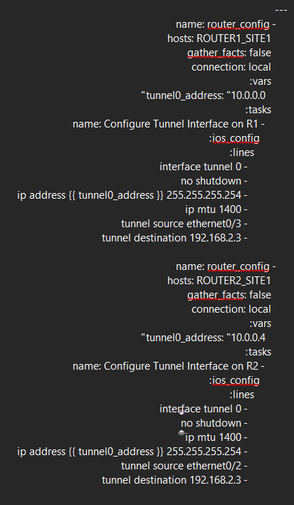
GOAL - This script automates the configuration of Tunnel Interfaces on Router 1 and Router 2. It is my first script, demonstrating the efficiency of network automation.
I created Tunnel 0 on Router 1 with the following configurations: the interface is enabled, assigned an IP address of 10.0.0.0 with a subnet mask of 255.255.255.254, the MTU is set to 1400, the tunnel source is ethernet0/3, and the tunnel destination is 192.168.2.3.
Similarly, I created Tunnel 0 on Router 2 with the following settings: the interface is enabled, assigned an IP address of 10.0.0.4 with a subnet mask of 255.255.255.254, the MTU is also set to 1400, the tunnel source is ethernet0/2, and the tunnel destination is 192.168.2.3.

Slide 26
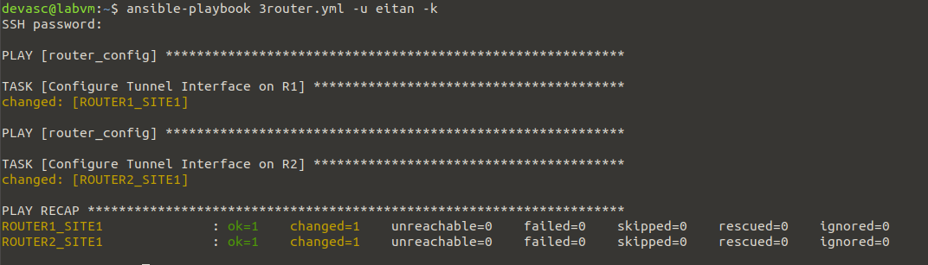
The output shows that the script executed successfully. The tasks for configuring the Tunnel Interface on both Router 1 and Router 2 were completed without any issues. The "changed=1" status indicates that the configurations were applied correctly, confirming the script's effectiveness in automating the setup of tunnel interfaces.

Slide 27
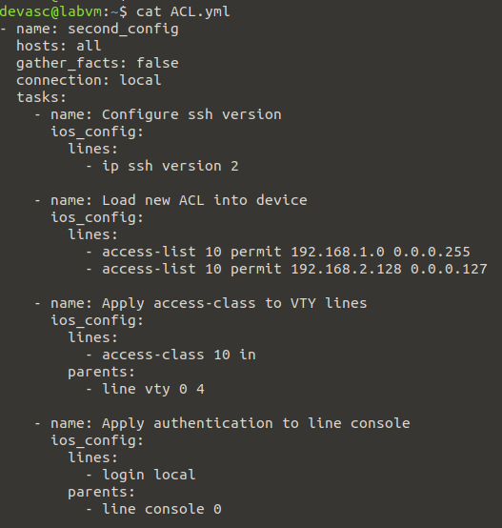
GOAL - This script automates the configuration of SSH settings, Access Control Lists (ACLs), and line settings on all specified routers. It serves as my second script, showcasing the continued advancement of network automation.
I configured SSH version 2 on the devices for enhanced security. Additionally, I created an ACL with the following entries: it permits traffic from the 192.168.1.0/24 network and the 192.168.2.128/25 network – meaning the IT department in site 1 and site 2 to gain remote access. I then applied this access-class to the VTY lines to control incoming SSH connections. Lastly, I set the console line to use local authentication to ensure secure access management.

Slide 28
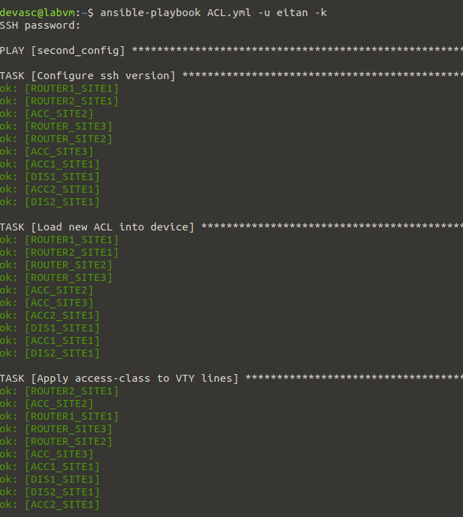
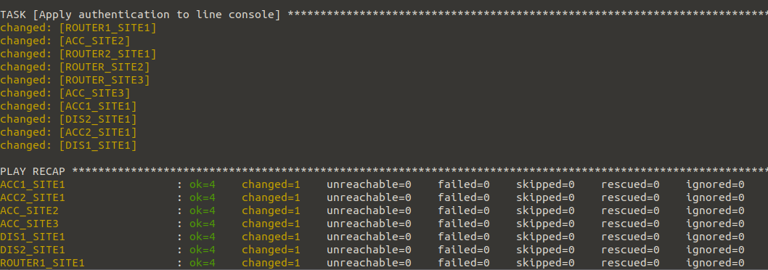
The output indicates that the Ansible playbook ran successfully across all devices. SSH was configured to version 2 for secure communication. New Access Control Lists were loaded without changes, and the access-class was applied to the VTY lines. The console line authentication was updated on several devices, reflecting the implementation of local login requirements. Overall, the playbook effectively enhanced the security and management of the network devices.

Slide 29
---
- name: enable_password
hosts: all
gather_facts: false
connection: local
vars:
ACC2_SITE1: 'LSkawm132d5'
ACC1_SITE1: 'aldwm2143k2'
DIS2_SITE1: 'msoa2k32n'
DIS1_SITE1: 'akmn23kn32'
R1_enable_password: 'iloerm394jk'
R2_enable_password: 'wka230jmsa2'
R3_enable_password: 'aol3402k'
R4_enable_password: 'koladwdm2'
ACC_SITE2_enable_password: 'am2momwa232'
ACC_SITE3_enable_password: 'loodk12k3maw0'
tasks:
- name: Set enable password for R1
ios_config:
lines:
- enable secret {{ R1_enable_password }}
when: inventory_hostname == 'ROUTER1_SITE1’
- name: Set enable password for R2
ios_config:
lines:
- enable secret {{ R2_enable_password }}
when: inventory_hostname == 'ROUTER2_SITE1'
This section of the script sets enable passwords for Router 1 and Router 2.
The passwords are defined as variables: R1_enable_password is set to 'iloerm394jk' for Router 1, and R2_enable_password is set to 'wka230jmsa2' for Router 2.
The script applies these passwords using the enable secret command based on the hostname of each router, ensuring that the appropriate password is configured on the correct device.

Slide 30
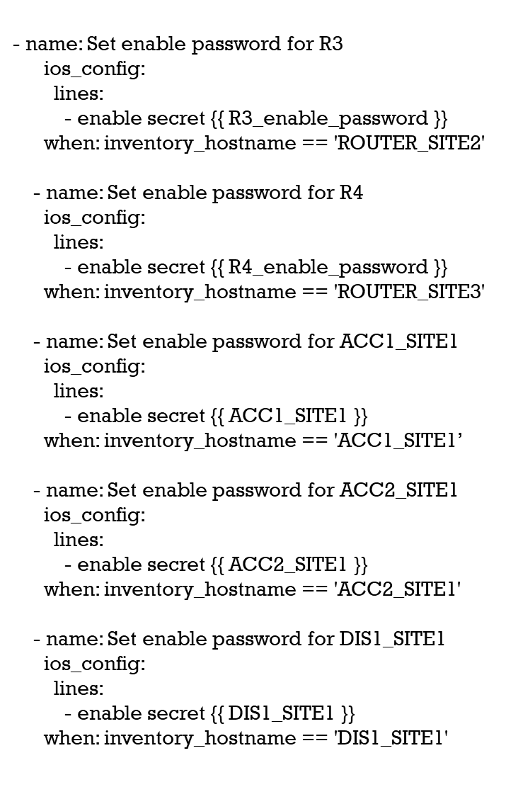
This is the second part of the script, which sets enable passwords for Router 3, Router 4. Additionally, it sets enable passwords for access devices: ACC1_SITE1 with the password 'aldwm2143k2', ACC2_SITE1 with 'LSkawm132d5', and DIS1_SITE1 with 'akmn23kn32'.

Slide 31
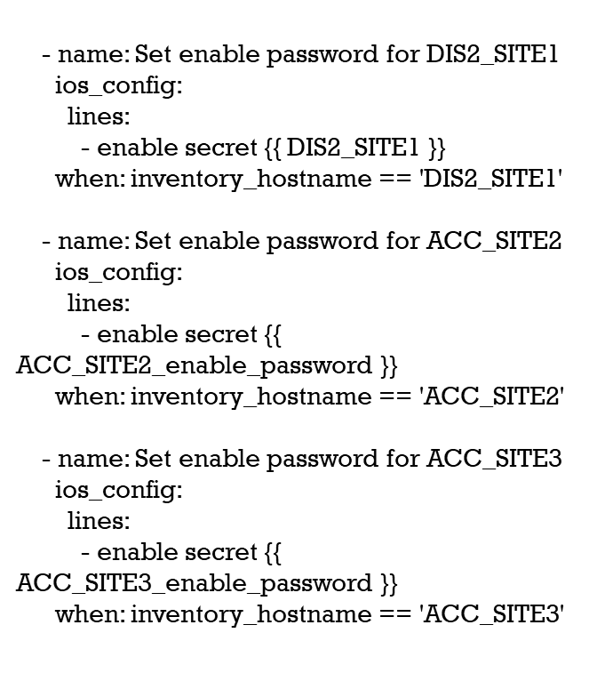
This is the last part of the script, which sets the enable passwords for DIS2_SITE1, using the password defined as DIS2_SITE1, which is 'msoa2k32n'. Next, it sets the enable password for ACC_SITE2, utilizing the variable ACC_SITE2_enable_password with the value 'am2momwa232'. Lastly, it sets the password for ACC_SITE3 using ACC_SITE3_enable_password, which is 'loodk12k3maw0'.

Slide 32
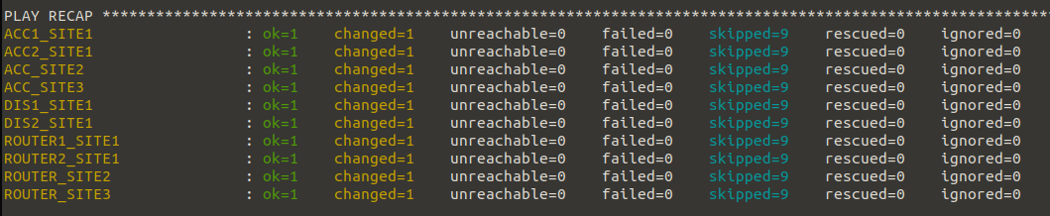
In the output, we can see that each device executed its corresponding task successfully, with the changed=1 status indicating that the enable password was set correctly. The term skipping appears for nine tasks on each device, which shows that they did not apply changes for tasks not applicable to them. This behavior is expected because the script uses conditionals based on the inventory_hostname to determine which enable password to set. Each device correctly skipped the tasks that were not relevant, confirming that the logic in the playbook is functioning as intended. Overall, the playbook ran smoothly, and all devices updated their enable passwords without errors.

Slide 33
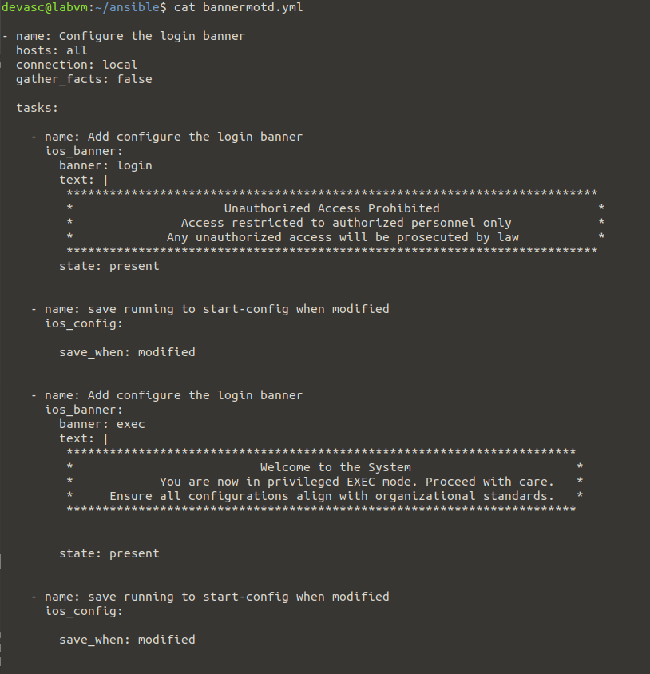
A script creating exec and login banners
For all of my devices.

Slide 34
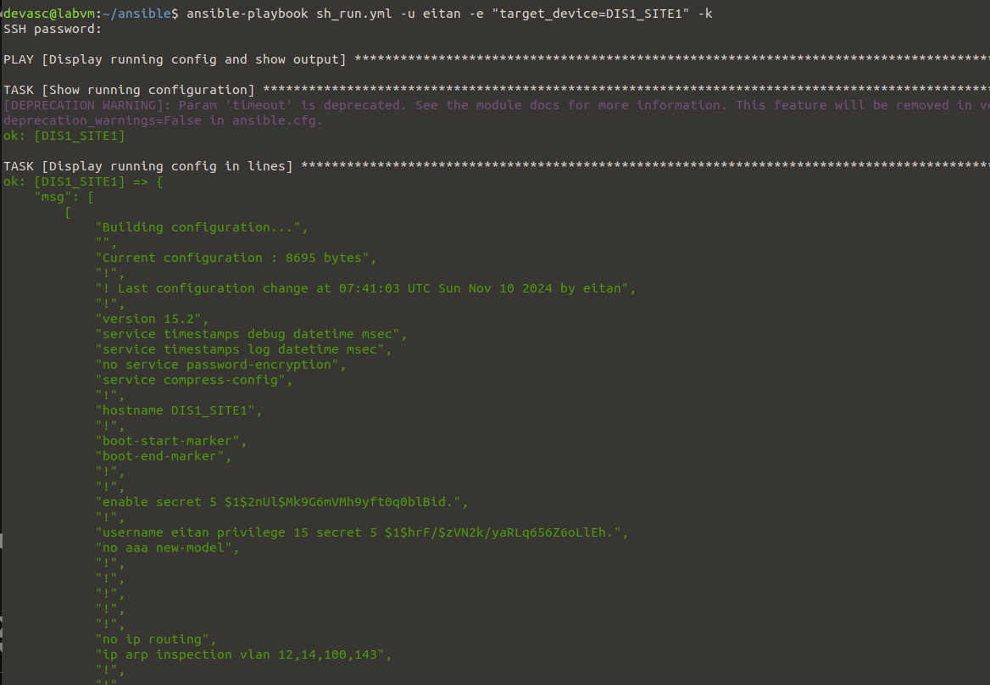
A script pulling the Show running-config of a device
And displaying it on cli
---
- name: Display running config and show output
hosts: {{ target_device }}
gather_facts: false
connection: local
tasks:
- name: Show running configuration
ios_command:
commands:
- show running-config
timeout: 30
register: result
- name: Display running config in lines
debug:
msg: "{{ result.stdout_lines }}"

Slide 35
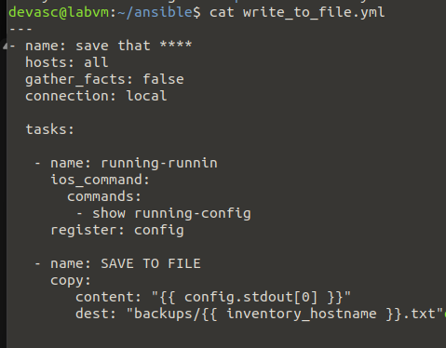
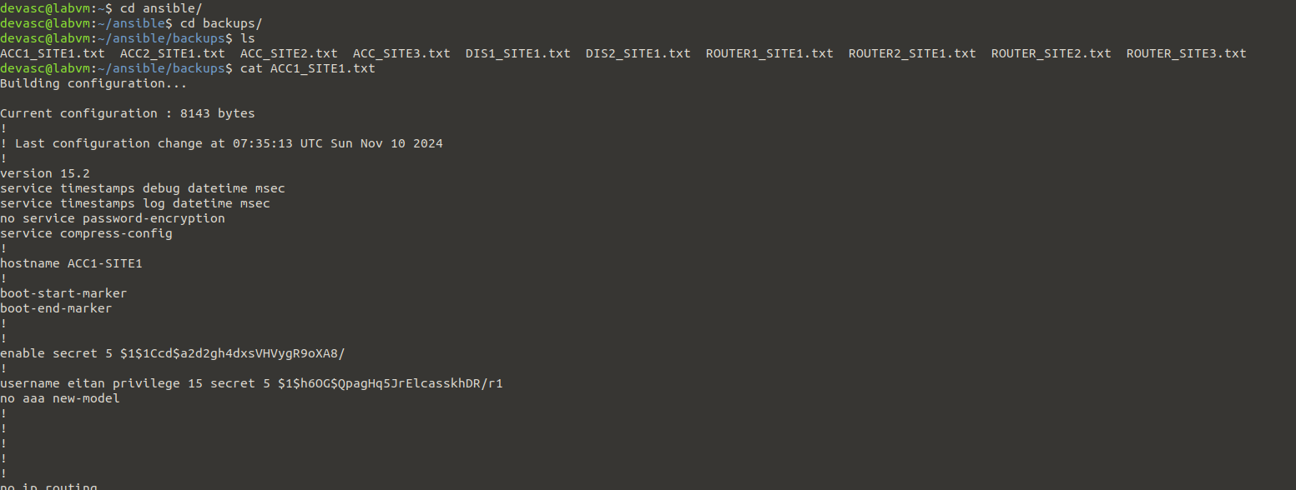
A script pulling the nvram of all devices and saves them in “backups” directory

Slide 36
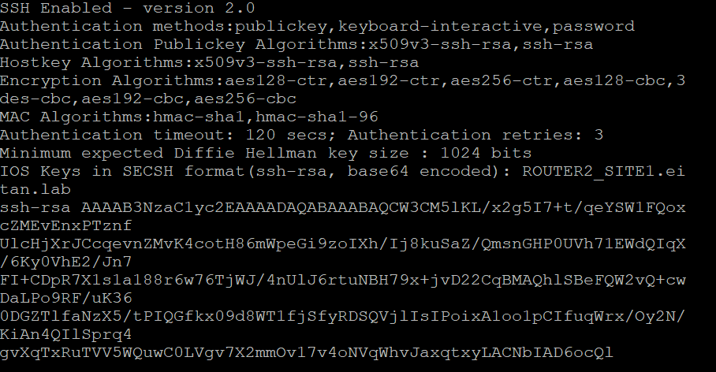
Strengthening Security with SSH
Enabling SSH
SSH was enabled on all devices with several key configurations. The domain name "eitan.lab" was set, along with their hostname for identification. The command "transport input ssh" was applied to the VTY lines to disable insecure protocols like Telnet. RSA keys were generated with "crypto key generate rsa," and "ip ssh version 2" was configured to enforce SSH version 2, which enhances security. These steps establish a secure environment for remote management.

